Slide 1
Developing BI Applications
Notes:
Lecture 12: BI - 1

Slide 2
Outline
Business Intelligence (BI) Primer
BI Tools in SharePoint 2010
Excel Services
Performance Point Services
Notes:
Lecture 12: BI - 2

Slide 3
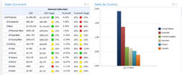

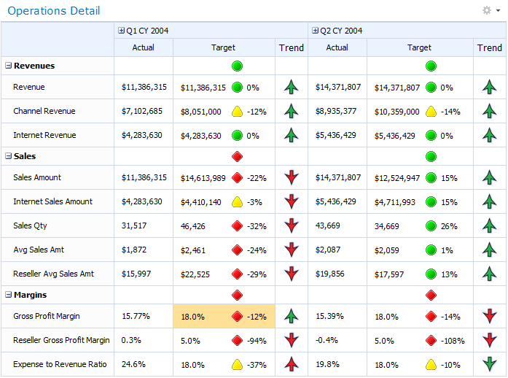
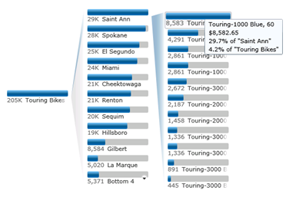
What is Business Intelligence?
A category of methodologies and technologies for gathering, storing, analyzing and providing access to data to help enterprise users make business decisions.
Notes:
This definition implies several facts. First to analyze the organization’s information, we need to get at it. That information may be:
- stored in multiple locations and in different format (SP Lists, Databases, OLAP Cubes, Excel, etc…)
- organized in different ways (relational, reports, etc…)
- presented in different Uis (Web sites, Excel Workbooks, custom application)
Simply bringing this information together for one person to analyze isn’t enough. That one person needs to be able to share their work with others and collaborate to find solutions. Then they need to share those solutions with others. The key point is that it’s not just enough to find the answers on your own if you can’t share them. Also finding the answers is easier when multiple people can collaborate effectively.
The rest of the presentation will focus on how we use tools to bring this information together and allow analysts to examine and collaborate with others to gain the knowledge they need to drive business decisions.
Lecture 12: BI - 3

Slide 4
Business Intelligence Applications
Summarize business critical operations
Purchasing, finance, investments, etc…
Used at multiple organizational level
Executive, Accounting, Personal
Often embedded in larger processes
Notes:
Focus on Business Intelligence applications as part of a larger process. They’re primarily used to perform analysis of information but that information can be presented in multiple ways to different groups. Finance and Investments will share some of the same analysis but may have it presented in different ways.
That same data may be presented to different groups of consumers and their needs may vary. The executive group may need relatively static indicators but the accounting department may need more dynamic indicators and charts. The BI apps in one sense are relatively static but in another are ad-hoc and can be customized to fit a situation and shared between peers.
Finally the information can be presented as part of a decision making or operational process. This is a great tie in to the workflow aspect of SharePoint. OBA applications can be made up of custom plugins to Office applications that gather present information along side the document being created. Once the document is created it becomes part of a process and the key business intelligence needed to make decisions as the document moves through the process can be presented in one place.
Both scenarios are important and the rest of the section will show how the BI tools in SPS 2010 enable both scenarios.
For a real world example for Collaborative Analysis:
Marketing needs to evaluate the success of a specific campaign to determine how to proceed on an upcoming campaign. They use Excel to access their sales data and attempt to correlate sales by region with the different campaigns run. One analysis focuses on the West Coast region and another focuses on the East Coast region. They each perform their analysis independently publishing their results to Excel Services allowing others to not only see the results, but see and explore the models they use. As the analysis continues they can all collaborate and add their observations to a collaborative portal in SharePoint resulting in the appropriate models. Once their models are complete, they can be aggregated with reports to provide a single location to view marketing success.
For a real world example of Planned Implementation
-Management needs a single place to view key indicators and reports that provide insight into the business. A plan is put into place that includes a detained design of the information needed. A project is started that first gathers the data needed and exposes it in a well planned dashboard that is exposed to those who need the information. There is a some configurability such as custom filtering and relationships between the items in the dashboard, but on a whole the implementation is relatively static compared to the ad-hoc scenario.
Lecture 12: BI - 4

Slide 5
Outline
Business Intelligence (BI) Primer
BI Tools in SharePoint 2010
Excel Services
Performance Point Services
Notes:
Lecture 12: BI - 5

Slide 6
BI Tools in SharePoint 2010
Status Indicators
Chart Web Parts
Performance Point Services
Excel Services
BI Search
Visio Services
Notes:
These tools range from front end components that help summarize and visualize data:
- KPIs and Charting Web part
To systems that provide a client and server component to provide robust display and analysis of data:
- PPS and Excel Services
To a back end component that will allow users to find information in multiple BI sources
- BI Search
Lecture 12: BI - 6

Slide 7
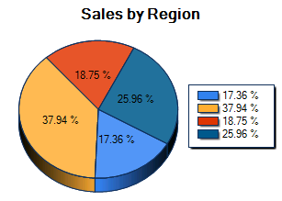
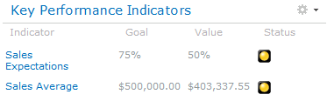
SPS 2010 BI Web Parts
Simple web parts that provide visualization
Quick summary of data
Can access multiple data sources
Fixed Values
Lists and External Lists
Excel Services
SQL Analysis Services
Other Web Parts
Lists and External Lists
Excel Services
Notes:
Both of these web parts can be completely configured in the browser. The key scenarios around these web parts is that they don’t need any back end services.
Each can retrieve data from multiple sources
Fixed Values – represents the fact that the KPI can tie to a specific value that is manually entered. Ex. An overall status that can’t be calculated such as a judgment decision by a manager
Lists and External Lists – represents list data or list data that comes from BCS. This opens up any data source since BCS can pull data from a database, services, or .NET code
Excel Services/Analysis Services – represents that anything in external data services can be pulled up as well
Other Web Parts – represents that the Chart Web Part understands that other web parts can be used to perform basic analysis and the Charting Web Part can expose it.
For example this chart could be done in Excel, but that would require the data that can already be surfaced in SharePoint to be read and rendered by Excel. The Charting Web Part allows basic charting of data to be accomplished in the browser without the need for the excel engine.
Lecture 12: BI - 7

Slide 8
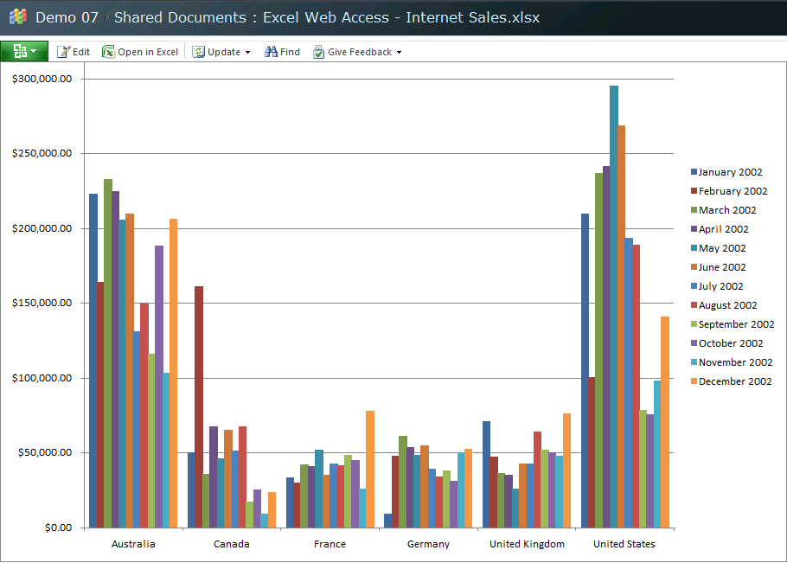
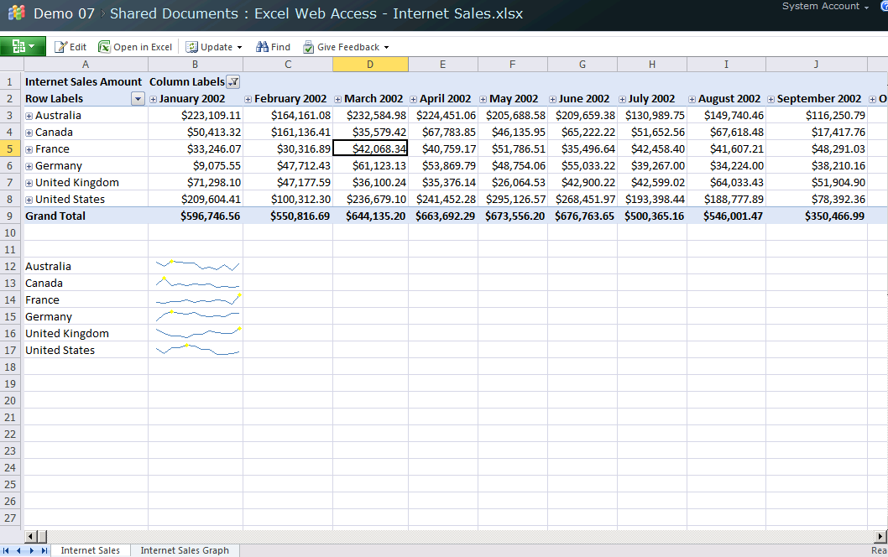
Excel Services
Provides a browser thin client for Excel
Allows trusted distribution of Excel Workbooks
Users can expose Excel content in Web Parts
Provides workbook data using service APIs
Notes:
Excel services becomes a host for the calculation engine of excel. This calculation engine is now hosted in Excel and the web service offering a thin client.
By exposing Excel in a shared, securable environment the analysis and applications created in Excel can be exposed to a larger set of consumers. It’s not about the rich client experience or the web thin client experience it’s about how they both can be used together to expose data, functionality, and analysis in a collaborative environment.
Lecture 12: BI - 8

Slide 9
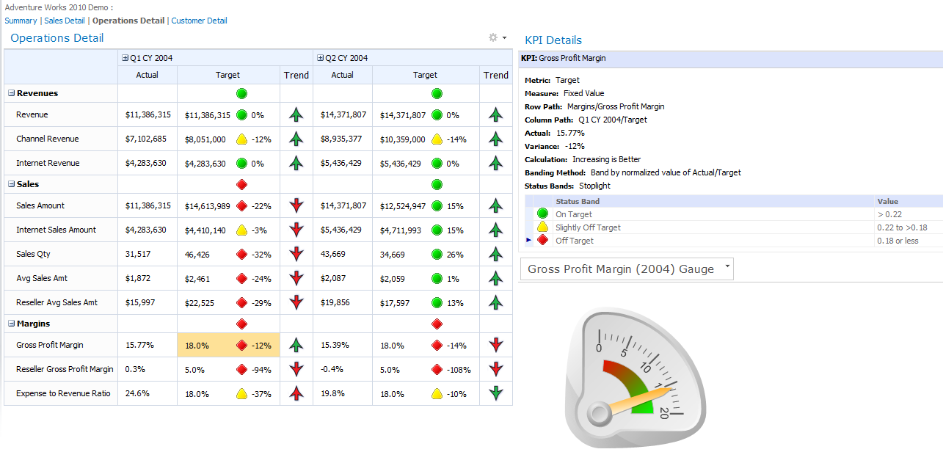
PerformancePoint Services
Context-driven dashboards across systems
Provides transparency and accountability
Interactive access using browser
Can be created/updated by IT professional
Notes:
Provides a summary of information that has been chosen by the dashboard and scorecard designer. The usage process would be an analyst or IT Pro would create a dashboard using the dashboard designer application and publish it to a SharePoint site. End users would then be able to view the live data summarized for them. This summary allows them to get a quick view of an entire set of systems allowing them to make effective business decisions and identify issues as soon as possible.
Focus on the concepts of IT enabling the business users to be self-sufficient. It allows them to see the information they need in an aggregated environment giving them the information the need to make decisions.
Lecture 12: BI - 9

Slide 10
Reporting Services
Professional report authoring environment
Designed for developer or IT professional
Does not ship with SharePoint 2010
SP 2010 has Reporting Services Web Parts
Used to create professional reports for BI apps
Notes:
Lecture 12: BI - 10

Slide 11
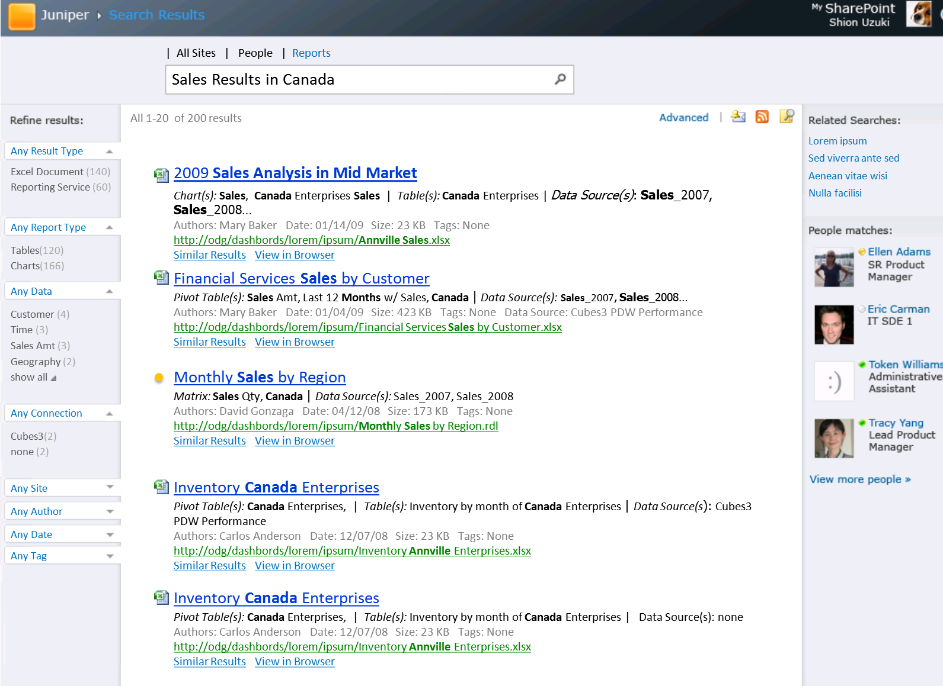
BI Search
Extends the reach of search to BI elements
Adds Excel and Reporting Services to search
Presents results based on dimensions
Links directly to specific view of the report
Notes:
Make sure you mention that this will ship AFTER RTM as a plugin. It requires SPS 2010 Enterprise and a FAST search server.
The primary usage of this functionality is that it takes searching beyond simple analysis of data in a document. It adds understanding of reports to the search process. The search plugin will understand that if it finds a term you need in the dimension of a report, that the link should (if possible) link with that dimension value in the filters. If you search for sales in Canada, you don’t want to see sales in the US when you click the link.
Lecture 12: BI - 11

Slide 12
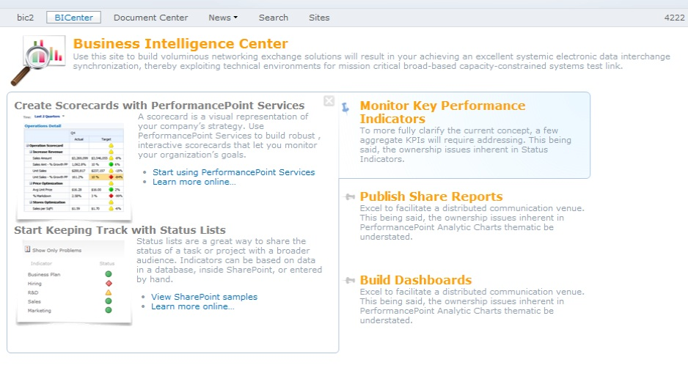
BI Center Site Template
Evolution of the Reporting Center template
Predefined lists for PPS, Excel Services
Starting point for BI portals
Notes:
There’s really not much to say here other than it exists. It’s a good starting point for those who are just learning about BI in SharePoint as it has some helpful examples of what can be done.
Lecture 12: BI - 12

Slide 13
Chart Web Part
demo
Notes:
Build a simple list of data
Sales by region
Have two columns, region name and sales
Connect to the list using access
Enter some sales for north, south, east, and west division
Create a simple bar chart using the data
Modify the data in access and see it update in the ui
Go to chart display wizard
Change to pie chart
Add a chart label
Lecture 12: BI - 13

Slide 14
Outline
Business Intelligence (BI) Primer
BI Tools in SharePoint 2010
Excel Services
Performance Point Services
Notes:
Lecture 12: BI - 14

Slide 15



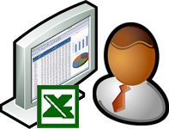

What is Excel Services?
Server hosting of Excel calculation engine
Provides a web thin client for Excel workbooks
Excel aggregates data from multiple sources
Exposes data using REST and JavaScript
Browser
Excel 2007
Custom applications
Notes:
Excel services extends the Excel experience to the web on top of a server hosted version of the calculation engine. This has several advantages. The most obvious is the ability to interact with Excel workbooks through a browser. This increases the reach of excel based data and applications.
Discuss the power of REST and Javacript APIs. Rest allows analysis to be exposed using a URL. You could embed the URL for a chart and retrieve current image from excel services on your web page. The Javascript API allows building custom script in a hosted environment like SharePoint Online that will use data from your excel workbooks to customize your UI. Excel in this case becomes another processing engine accessible to your shared applications.
Another advantage is the granularity of data exposed. Using ExcelServices web parts, IT can control which parts of the workbook are available. This allows more control of permissions to data. This will be discussed in the next slide.
Lecture 12: BI - 15

Slide 16
Management of Excel Content
IT can control parts of Excel Workbooks
Excel file sharing is all or nothing
Excel Services can expose smaller parts
Ex. Expose the results without exposing formula
Ex. Expose one summary chart, but not the raw data
IT can control permissions to each part
Notes:
An Excel workbook can be exposed in it’s entirety via the web or just specific parts. This increases the level of control available to IT and allows the creation of a complete data model in Excel while allowing users to only see part of it.
One scenario is a complex Excel application. This application uses algorithms that are proprietary. If we let anyone see the Excel file, they can see them. If we only expose the inputs and outputs through Excel services, our intellectual property is protected.
Another scenario is a Excel document that imports a set of data showing exactly what everyone in the organization is paid and a pivot chart that aggregates the data to show a summary. The summary is visible to the entire company, but the details shouldn’t be. By exposing only the summary via Excel services, everyone can see real time data of the summaries without seeing the raw data that is private.
Lecture 12: BI - 16

Slide 17
Exposing Excel Content
Content can be exposed in a variety of ways
Publish workbook to a SharePoint site
Entire workbook, specific sheets, specific items
Web Services
REST Services
Javascript Object Model
Notes:
We’ll focus on the first option here, the others will be discussed in more detail in another module.
Focus at a high level on how Excel services is not just about providing the thin or web client UI for visual consumption, it can provide raw data or other presentations.
A Web Services scenario would enable a rich client application to access the raw data leverage Excel’s calculation engine.
A REST Services scenario would be embedding a chart rendered in Excel in a web page. Since it’s retrieving the data from Excel services it gets a chart based on live data. Since it’s using REST the http infrastructure for caching can enable more efficient distribution of the content.
A JOM scenario would be a rich dashboard application on a sharepoint page that ties together Excel workbooks. This scenario is even more compelling in sandboxed scenarios since it allows creation of apps with no custom server side code.
Lecture 12: BI - 17

Slide 18
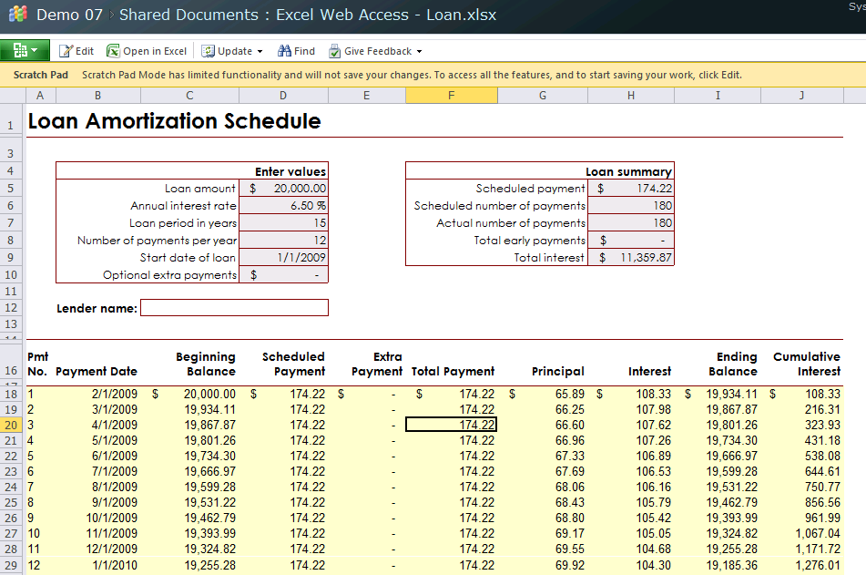
Existing Excel applications
Excel data “trapped” in existing workbooks
Excel Services lets us expose this information
Users can interact and collaborate
Excel “applications” can be exposed on web
Notes:
Many existing Excel applications and forms exist. Instead of rewriting the functionality, these existing documents can be stored in SharePoint and exposed via Excel services. Using a combination of web parts to expose the data and custom Javacript accessing the Excel Services object model, these applications can be combined via the Portal.
This allows leveraging of existing work while enabling the connections and collaboration wanted in a portal environment.
Lecture 12: BI - 18

Slide 19
Excel Workbooks in the browser
Provides a browser based view of Excel
Allows interaction with Excel Workbook
Ex. Pivot Table, Sorting, Filtering, Parameters
Notes:
Lecture 12: BI - 19

Slide 20
Excel Services Web Parts
Excel Services exposed using Web Parts
Web Parts display named items
Parameters exposed as Web Part connections
Parameter changes will update charts
Allows real time feedback to users
Notes:
Lecture 12: BI - 20

Slide 21

Excel Services + Gemini
In-memory Data Cubes in Excel
Excel addin allows creation of cube
Cube persisted in the Excel Workbook
Consumers of workbook have access to cube
Excel Services
Gemini
Browser
Excel Workbook
Notes:
Gemini is co-developed by Excel and Analysis Services teams and allows Excel to process cubes client side and allows Analysis Services to aid in processing server side.
Requires Analysis Services on a server in the SPFarm
- Connected by an Analysis Services Shared Service
A usage scenario would be for an Analyst to download the Gemini addin (free) and then perform an analysis in Excel aggregating as many data sources as necessary. Once the analysis is done, they publish their workbook to SharePoint. The In-Memory cube they created is published in the Excel document as well. At this point the Excel file is used like any other Excel file, but it has the cube persisted inside of it.
When the file is opened by Excel Services, the cube is handed off to Analysis Services Shared Service in the SPFarm for management. This allows the calculations be be done in a shared services environment while providing the functionality needed to Excel Services while still allowing the client side operation to stay the same as always.
Lecture 12: BI - 21

Slide 22
Excel Services
demo
Notes:
Build a simple pivot table to interact with
Attach a pivot table to Adventure Works Cube
Use Internet Sales as measure, Sales Territory on the Columns, and Date.Calendar on the row
Add a pivot chart on a second sheet
Name the chart
Publish to SharePoint
View in Web Page and explore options
Explain security options SSS vs None and how unattended service works
Show Excel Services configuration
Explore REST options
Browse to a chart in a web part and see the image displayed in the browser
http://moss.contoso.com/_vti_bin/ExcelRest.aspx/sites/Demo07/Shared%20Documents/Internet%20Sales.xlsx/Model/Charts('Chart%201')
Add the link to a page in the site to show relationships
Change the data and refresh the page to see the changes
Expand/collapse an item in the pivot chart
Lecture 12: BI - 22

Slide 23
Outline
Business Intelligence (BI) Primer
BI Tools in SharePoint 2010
Excel Services
Performance Point Services
Notes:
Lecture 12: BI - 23

Slide 24
Context-Driven Dashboards
Brings the data to non-BI users
Allows users to navigate and explore analysis
Slice, Dice, and Drill through the data
Apply custom filtering, sorting
Choose Top/Bottom N items
Change displays (ex. Grid to Chart)
Provides design environment for Power Users
Provides browser view for business users
Notes:
Lecture 12: BI - 24

Slide 25
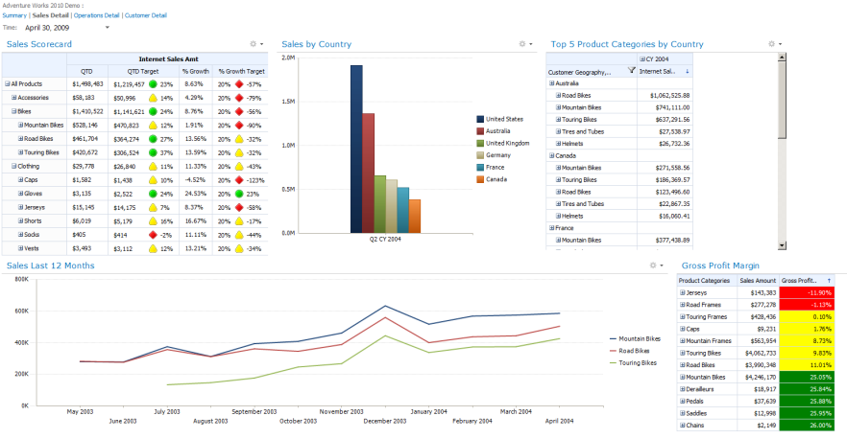
What are Dashboards?
Visual displays of mission critical analysis
Answers fundamental business questions
Single screen display of information
“Real Time” summary of data
Interactive links to details
Notes:
Make sure the concept of a BI dashboard is discussed as a lead-in to the dashboard designer. Focus on how dashboards provide the container that we store other content in. Discuss the relationships between items in the dashboard and how one can effect another.
The goal of a dashboard is to provide all the business information a user needs right in front of them while allowing them to quickly and easily explore any aspect as needed.
For example they could see that the projected sales for an region are lower than expected on the main page. They should be able to select that region and see the charts adjust to focus on that region. Then they should be able to drill into the data in one click to see more information and supporting reports.
Lecture 12: BI - 25

Slide 26
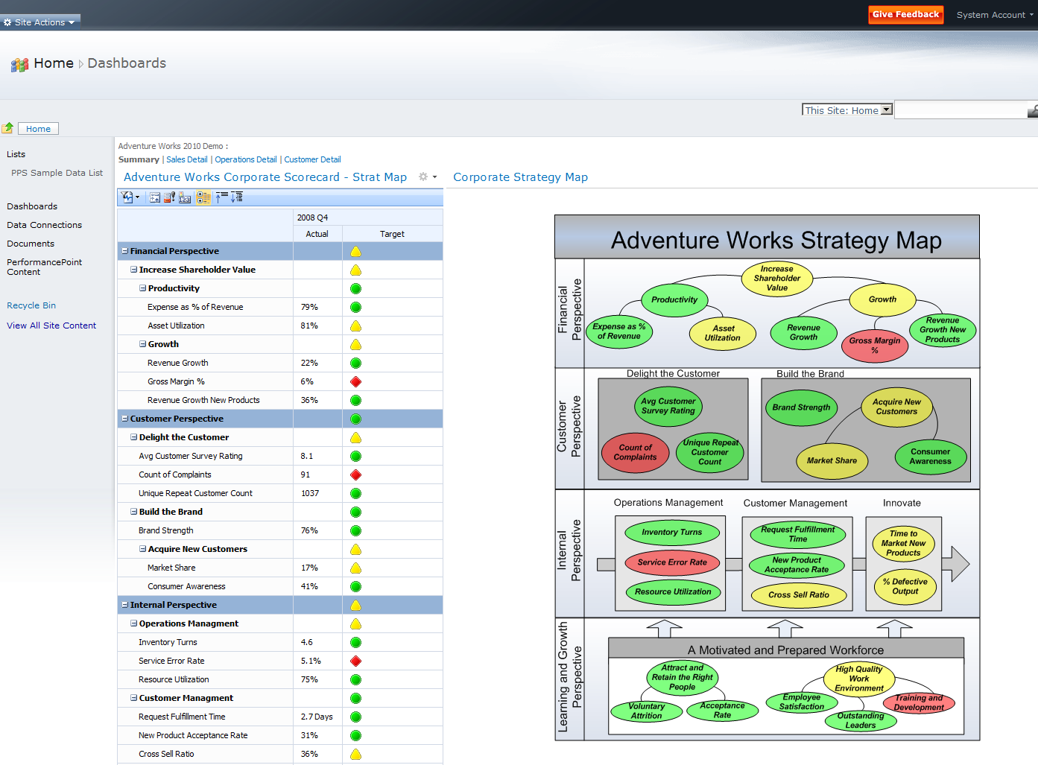

What are Scorecards?
Provides an overall view of status indicators
Modeled after the business not the data
Manages key performance indicators (KPIs)
Often included as part of a dashboard
Balanced Scorecard Certified
Notes:
Make sure the concept of a BI dashboard is discussed as a lead-in to the dashboard designer. Focus on how dashboards provide the container that we store other content in. Discuss the relationships between items in the dashboard and how one can effect another.
The goal of a dashboard is to provide all the business information a user needs right in front of them while allowing them to quickly and easily explore any aspect as needed.
For example they could see that the projected sales for an region are lower than expected on the main page. They should be able to select that region and see the charts adjust to focus on that region. Then they should be able to drill into the data in one click to see more information and supporting reports.
Lecture 12: BI - 26

Slide 27
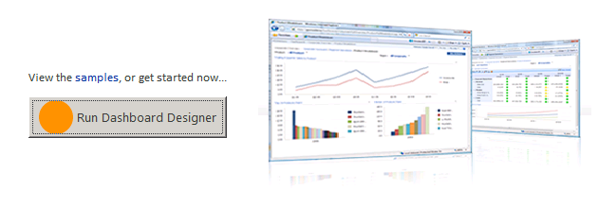
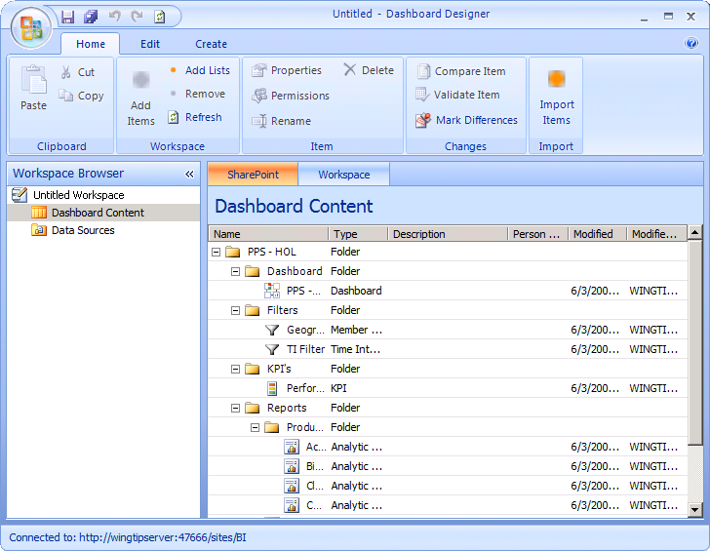
Designing PPS Applications
Dashboard designer used to create content
ClickOnce application launched from browser
Manages content directly in SharePoint
Lists for content, data sources, dashboards
Notes:
The DashBoard designer is how all items are managed. It’s an app that communicates with SharePoint using web services and client object model. All content is created in lists. An option on the list item is Edit in Dashboard Designer.
Lecture 12: BI - 27

Slide 28
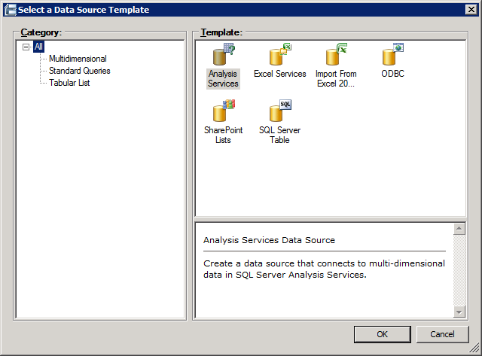
Aggregating Data Sources
Data access is managed with Data Sources
Data is accessible from multiple sources
Ex. Analysis Services, Excel, Lists, SQL, etc…
Accessed with service account or current user
Stored in list as an XML file (*.ppsdc)
Notes:
The data source is stored as a ppsdc file which is an xml file that contains all the information PPS needs to
Lecture 12: BI - 28

Slide 29
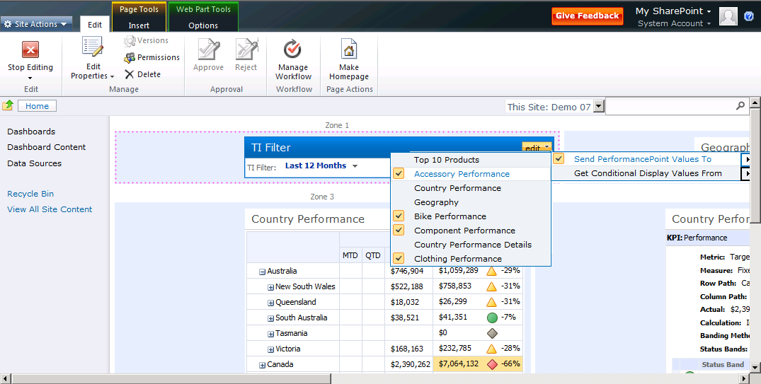
PPS Content in the Browser
Business users view content in the browser
Stored as Web Part pages
Web Part connections used to relate content
Ex. Item choice in a scorecard updates reports
Notes:
Focus on how the dashboard designer we’ve seen is only creating SharePoint content. All of the content exists in list inside SharePoint and is exposed via Web Parts.
Lecture 12: BI - 29

Slide 30
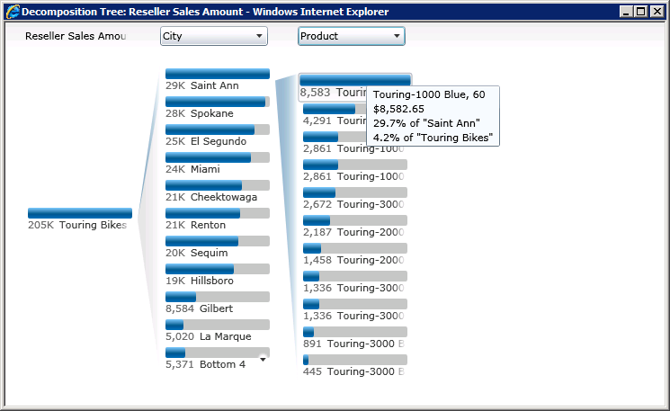
Visual Data Exploration
Decomposition trees allow data exploration
New in SharePoint 2010
Available by right clicking data in browser
Analyze -> Decomposition Tree
Allows filtering\expanding across dimensions
Notes:
Note that this allows cross dimension filtering. This allows understanding why certain conditions exists. For example why are we selling far more of one product in one area than another. It can help analysts determine which products are more popular in areas.
Lecture 12: BI - 30

Slide 31
Performance Point Services
demo
Notes:
Create a new performance point site collection (pull this from lab)
Create a simple data connection
Create a simple KPI using data
Put the KPI in a score card
Add filter
Put it all on a dashboard and publish it
Lecture 12: BI - 31

Slide 32
Summary
Business Intelligence (BI) Primer
BI Tools in SharePoint 2010
Excel Services
Performance Point Services
Notes:
Lecture 12: BI - 32

